Slide 1

Exploratory Analysis of Video Game Data in Central Illinois
Megan Cusey
MSD 546 Quantitative Methods Final Project

Slide 2
Details Regarding Information Available From Illinois Gaming Board’s Website
Data shown includes Auburn, Springfield, and Sangamon County Municipalities
VGT Count – Number of video game terminals at an establishment
Amount Played – Amount of money bet in all video gaming terminals at a location. This is includes money won by the player and put back into the machines
Amount Won – Amount of money won at a location
Net Wagering Activity – The difference between the amount played and the amount won at a location
Funds In – The actual cash put into the machines at a location
Funds Out – The actual amount of cash payed out by the machines at a location
Net Terminal Income – The actual net income generated by the machines a location
NTI Tax Rate – 30%
State Share – State’s share of taxes from a location
Municipality Share – The host community share of taxes

Slide 3
Introduction
The next few slides illustrate some interesting patterns for the Central Illinois Video Game Data…

Slide 4
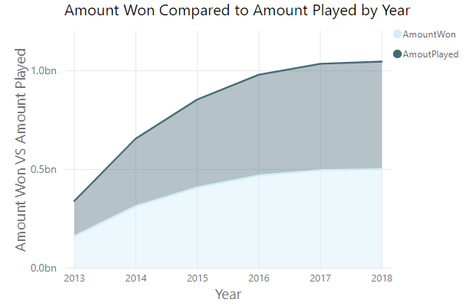
Summary of Data

Slide 5
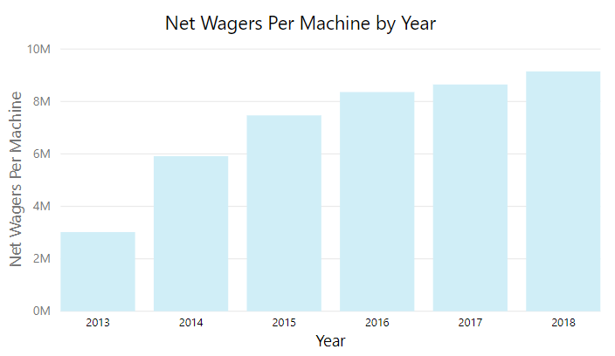
Summary of Data (Cont’d)

Slide 6
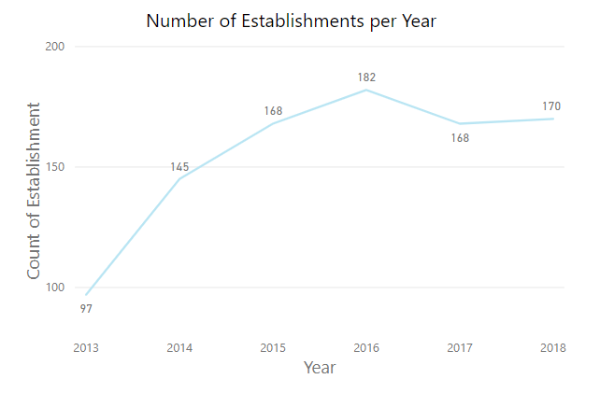
Summary of Data (Cont’d)

Slide 7
Objective #1
How does the number of video game terminals effect net wagers per location? Is there a significant difference in the mean of net wagers for establishments with different number of terminals?

Slide 8
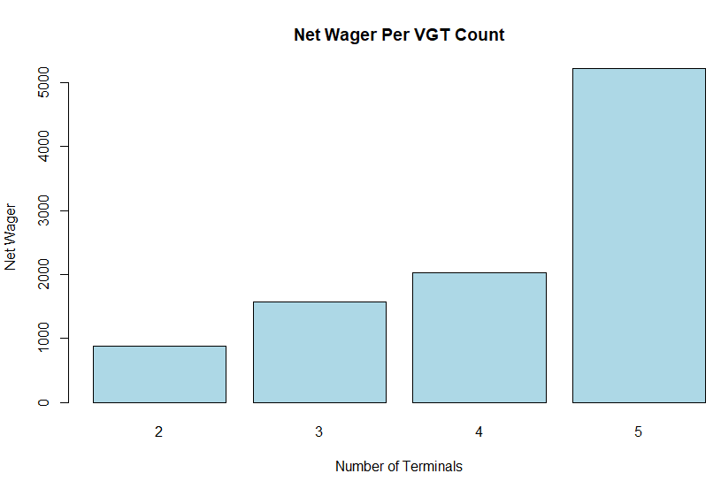

Slide 9
Objective # 1 Conclusion
Analysis of Illinois Video Game Data showed significant evidence to determine that there is a difference in the mean of Net Wagers Per Video Game Machine between establishments with different numbers of Video Game Terminals.
In other words, there is a significant effect on the Amount Played/Amount Won ratio as the number of video game terminals increase at an establishment that offers video gaming.

Slide 10
Objective #2
Since video gaming has become legal in the State of Illinois in 2012, there’s no doubt that the number of establishments that provide video game terminals have increased (as we saw in the summary of data). Does the net wager amount have a significant difference in mean between 2012 and 2019?

Slide 11
Objective # 2 Conclusion
Results of the analysis were inconclusive.
There is no significant evidence to conclude that the Net Wager Amount per video game terminal has increased or decreased throughout the years.

Slide 12
Objective #3
A friend has offered an alternative hypothesis that the mean of net wagers decrease in winter months. Is there a significant difference between the Net Wagers recorded in winter as opposed to other seasons?

Slide 13
Objective # 3 Conclusion
Results of the analysis were inconclusive.
There is no significant evidence to conclude that the Net Wager Amount has increased or decreased as a result of the seasons.

Slide 14
Suggestions for Future Studies
What other factors might effect the difference in mean for the Amount Played to Amount Won ratio for establishments with a different number of video game terminals?
Traffic?
Amount Deposited into the Machines?
Location?
What if we included the whole State of Illinois Data?
Is there any statistical evidence of a particular day of the week that brings more “luck” to video gamers?

